Slide 1

ME 165
Mechanical Engineering Fundamentals
Md. Aminul Islam
Lecturer
Department of Mechanical Engineering, BUET

Slide 2
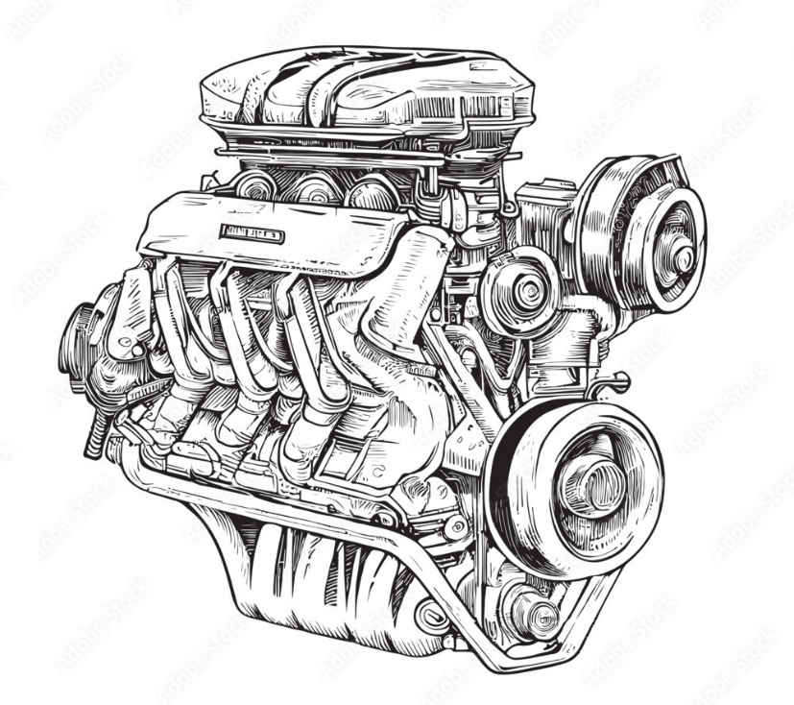
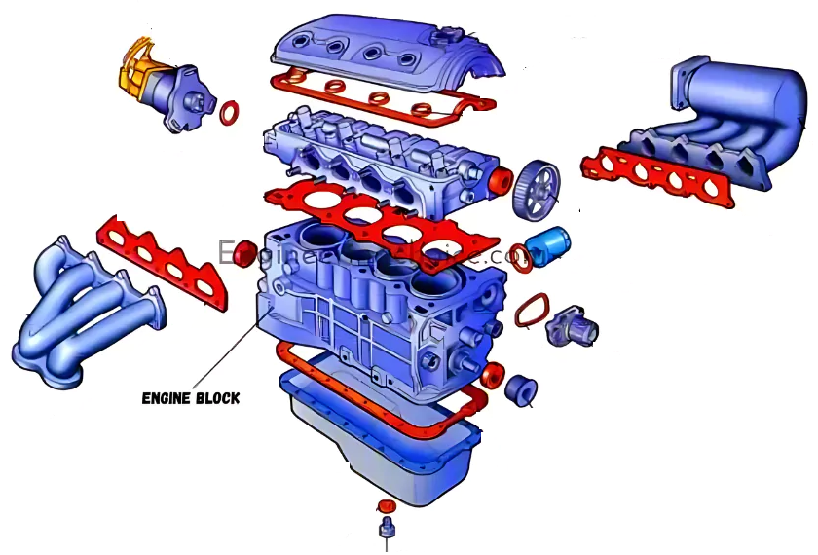
Internal Combustion Engines - Construction
Head block
Bottom Chamber

Slide 3
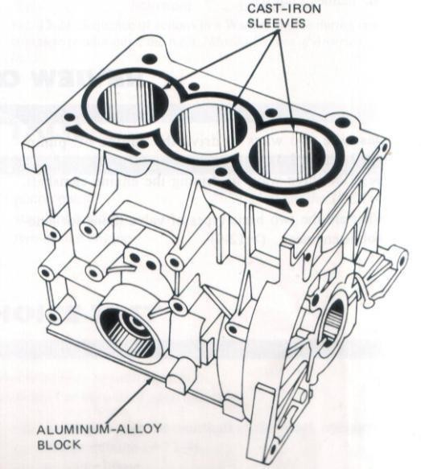
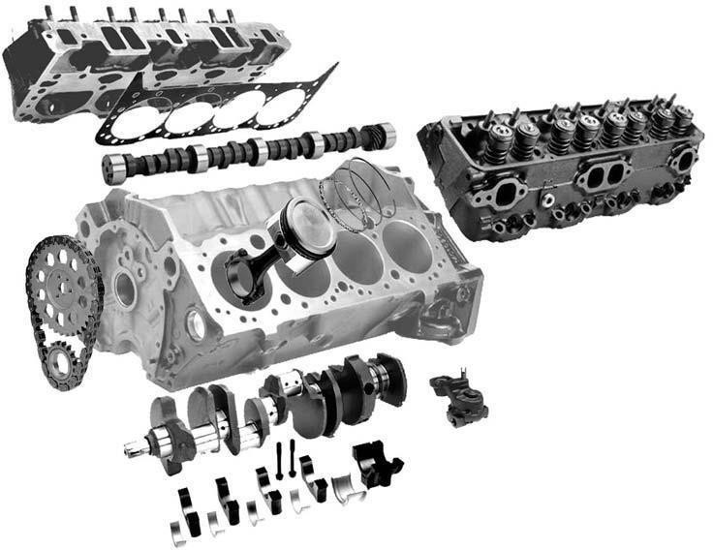
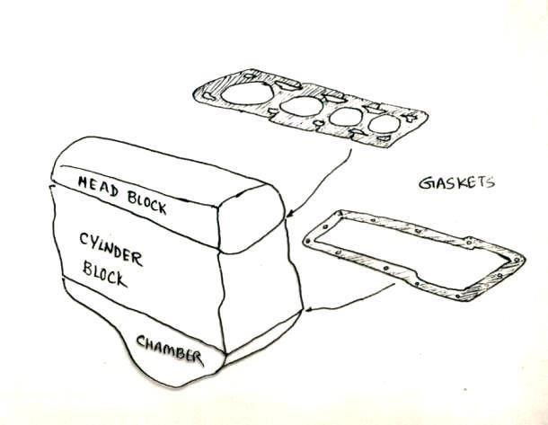
Internal Combustion Engines - Construction
The three main portions of an IC engine are
Head block: Top Part
Cylinder Block: Middle Part
Chamber or Sump: Bottom Part

Slide 4
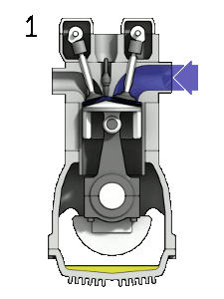
Internal Combustion Engine (IC Engine)

Slide 5

Spark Ignition (SI) Engine
https://www.youtube.com/watch?v=DKF5dKo_r_Y&t=136s

Slide 6
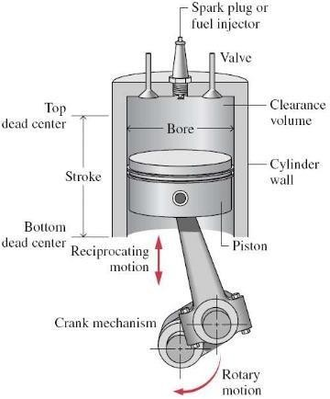
Spark Ignition (SI) Engine
4 stroke SI (Petrol) engine operation
Four stroke engines: the cycle of operation is completed in four strokes of the piston or two revolution of the crank shaft. Each stroke consists of 180⁰ of crank shaft rotation.
In an internal combustion engine, the piston executes four distinct strokes within the cylinder for every two revolutions of the crankshaft. The four strokes are termed as –
Intake Stroke
Compression Stroke
Power Stroke
Exhaust Stroke

Slide 7
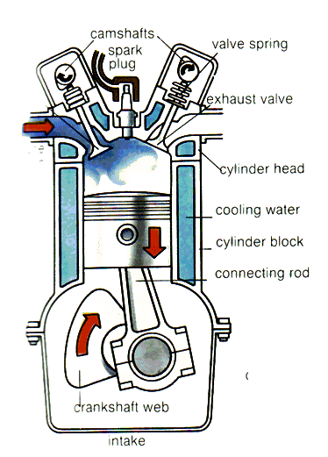
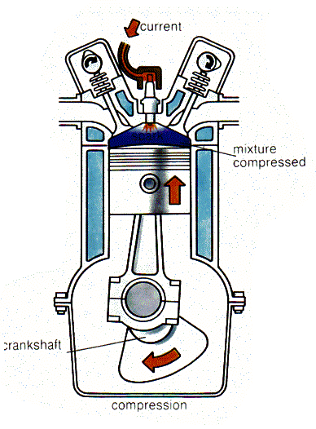
4 stroke SI (Petrol) engine operation
First stroke: intake or induction
Intake valve opens, and exhaust valve closes
Piston travels from TDC (top dead center) to BDC (bottom dead center)
Volume increases in combustion chamber and creates vacuum
Fresh charge is drawn into the cylinder due to suction.
For SI engine the charge is a mixture of fuel and air. For CI engines charge is only air (air passes through intake system, fuel is added)
Second stroke: compression
Piston reaches BDC, both intake and exhaust valves close.
Now piston rises from BDC back to TDC with all valves closed, compresses the charge (air-fuel mixture) raising the temperature and pressure. This stroke requires work input from Piston to the charge.
Near end of compression stroke, spark plug fires and combustion is initiated. In SI engines it is induced by spark plug. In CI engines combustion is initiated by injecting fuel into the hot-compressed air using fuel injectors.

Slide 8
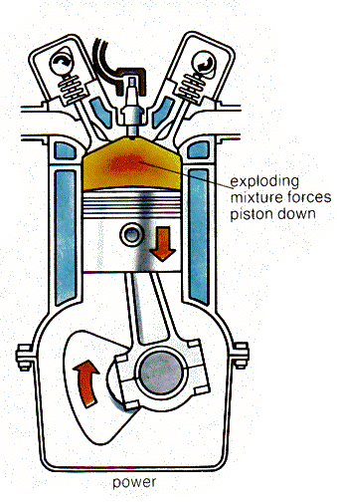
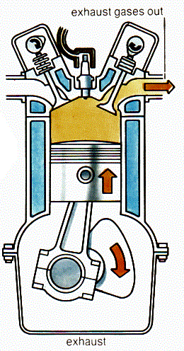
4 stroke SI (Petrol) engine operation
Third Stroke: Expansion or Power Stroke
Piston near TDC: nearly constant-volume combustion occurs.
Changes composition of gas mixture to exhaust products occurs due to exothermic blast and temperature and pressure increases.
High pressure pushes piston away from TDC. Work is done on the Piston as thermal energy is converted to mechanical energy.
Piston moves from TDC to BDC, volume increases and pressure and temperature drop
Fourth Stroke: Exhaust blowdown
Late in power cycle exhaust valve is opened.
Piston moves from BDC to TDC due to momentum gained
Pressure differential pushes hot exhaust gas out of cylinder and. through exhaust system when piston is at BDC.
Exhaust gas carries away high amount of enthalpy, which lowers cycle thermal efficiency

Slide 9
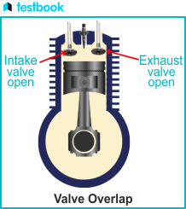
4 stroke SI (Petrol) engine operation
Near end of exhaust stroke before TDC, intake valve starts to open and is fully open by TDC when intake stroke starts next cycle
Near TDC the exhaust valve starts to close and is fully closed sometime after TDC.
Period where both intake valve and exhaust valve are open is called valve overlap

Slide 10
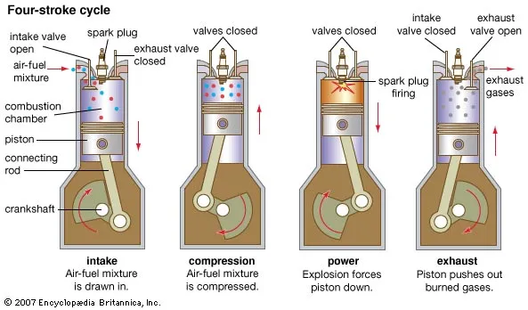
4 stroke SI (Petrol) engine operation

Slide 11

Engine Terminology

Slide 12
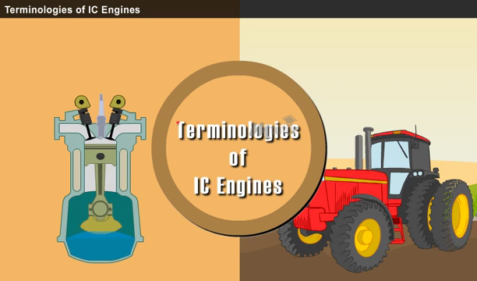
Engine Terminology
https://www.youtube.com/watch?v=SvJM4e1OotE

Slide 13
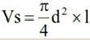
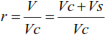
Engine Terminology
Swept or Displacement Volume
Compression Ratio

Slide 14
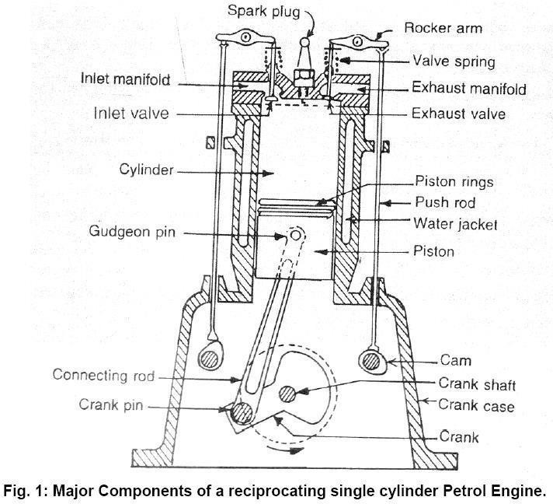
Engine Terminology

Slide 15
Engine Terminology
Piston Cylinder Assembly: It is the assembly for manipulating the working assembly is characterized by a piston moving inside the confined cylinder.
Inlet Valve: The valve through which air fuel mixture (in case of SI engine) or air (in case of
CI engine) is introduced inside the cylinder.
Exhaust Valve: The valve through which the products of combustion leave the cylinder.
Crank Mechanism: Mechanism to convert reciprocating piston motion to rotary motion.
Bore: Diameter of Cylinder.
Top Dead Center (TDC): Position of Piston where Cylinder Volume is minimum.
Bottom Dead Center (BDC): Position of Piston where Cylinder Volume is maximum.
Stroke: It is the maximum distance that the piston moves in one direction. It is the distance between TDC to BDC.
Clearance Volume (V_{c}): Minimum Cylinder volume when Piston is at TDC.
fluid. The

Slide 16
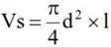
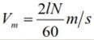
Engine Terminology
Clearance Volume (V_{c}): Minimum Cylinder volume when Piston is at TDC.
Swept or Displacement Volume (Vs or Vd ): Volume swept out by the piston as from TDC to BDC.
it moves
Where d is the cylinder bore and l the stroke
Compression Ratio (r_{v}): Ratio of maximum volume at BDC and minimum volume at TDC.
Mean piston speed: the distance traveled by the piston per unit of time.

Slide 17
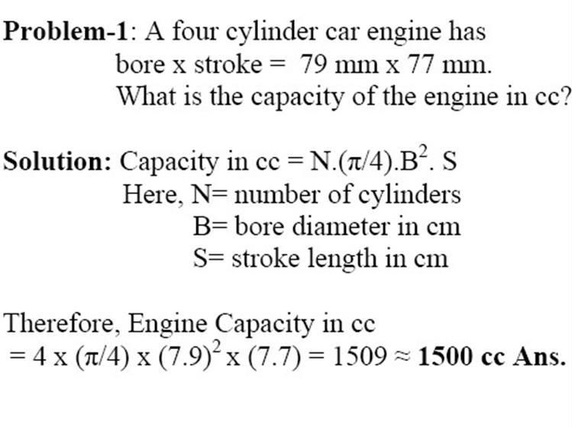
What is meant by cc in Engine?
The size of an engine is measured in cubic centimetres (cc) and refers to the displacement volume of the engine.

Slide 18
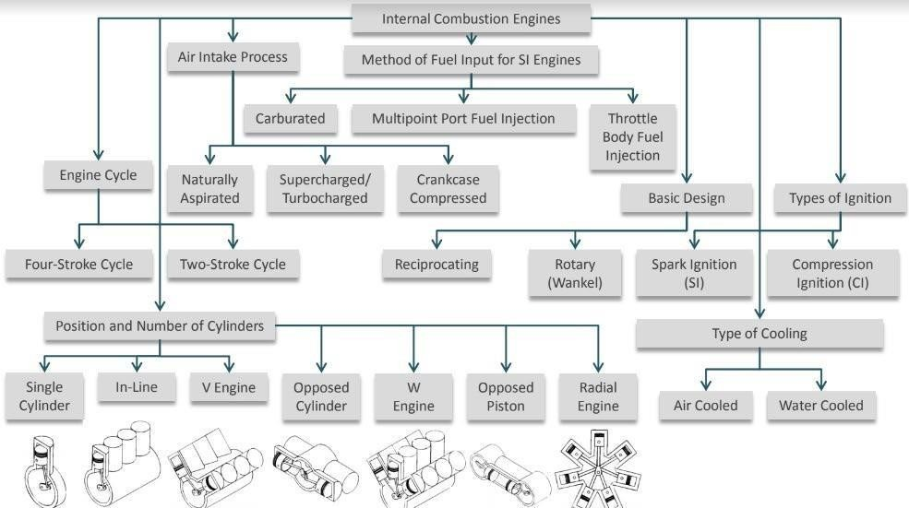
Engine Classification

Slide 19
Engine Classification
Method of Ignition
Spark ignition (SI): High-voltage electrical discharge between two electrodes ignites air-fuel mixture in combustion chamber surrounding spark plug. Example: Petrol Engine
Compression ignition (CI): Air-fuel mixture self-ignites due to high temperature in combustion chamber caused by high compression. Example: Diesel engine
Number of strokes per cycle
Four-stroke: Four piston movements over two engine revolutions for each engine cycle.
Two-stroke: Two piston movements over one revolution for each engine cycle.

Slide 20
Engine Classification
The type of fuel
Gasoline, Diesel or fuel oil, Gas (natural gas or methane), Liquefied petroleum gas (LPG): mainly propane, propylene, butane, and butylene
Alcohol (ethyl, methyl), Dual fuel (e.g. methane/diesel), Gasohol (e.g. 90% gasoline, 10% alcohol)compression.
Biodiesel: cleaner-burning diesel fuel made from natural, renewable sources such as vegetable oils.
The cycle of operation
Otto cycle (also known as constant volume cycle) engine
Diesel cycle (also known as constant pressure cycle) engines
Dual combustion cycle (also known as semi-diesel cycle) engines

Slide 21
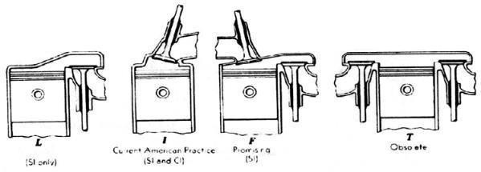
Engine Classification
Valve location
Valves in head
Valves in block
One valve in head and one in block (less common)

Slide 22
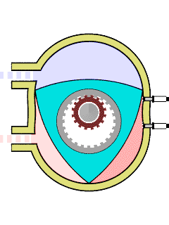
Engine Classification
Design
Reciprocating
Rotary
Number of cylinders
Single cylinder engines (e.g. lawnmowers),
Multi-cylinder engines.
The cooling system
Air cooled engine, (b) Water cooled engine,
(c) Evaporative cooling engines

Slide 23
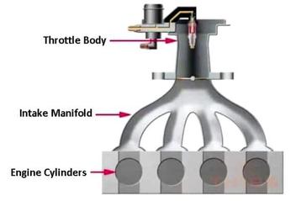
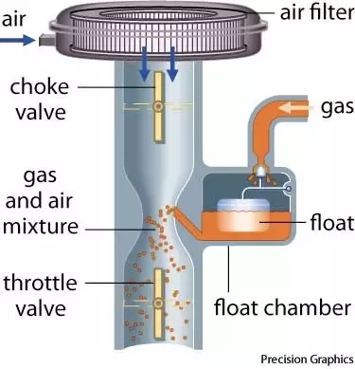
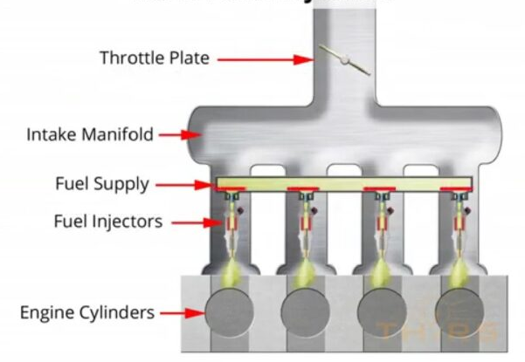
Engine Classification
Method of Fuel Injection
Carburetor
Throttle body Fuel Injection
Multi port Fuel Injection

Slide 24
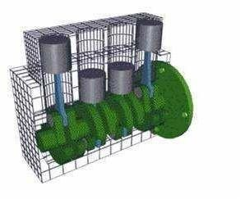
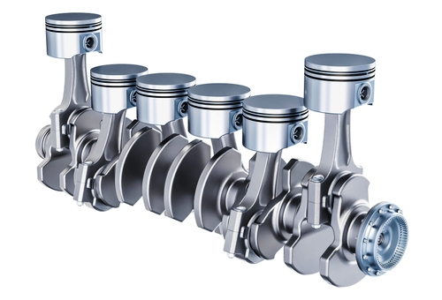
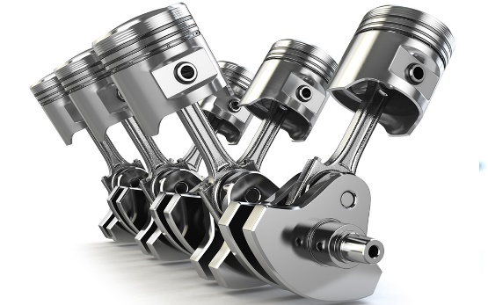
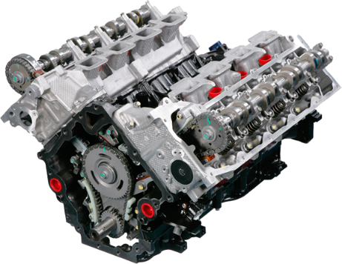
Engine Classification
Arrangement of cylinders:
In-line or straight: cylinders in straight line, one behind the other in length of crankshaft.
V:
two banks of cylinders at an angle with each other along a single crankshaft, angle typically 60-90⁰

Slide 25
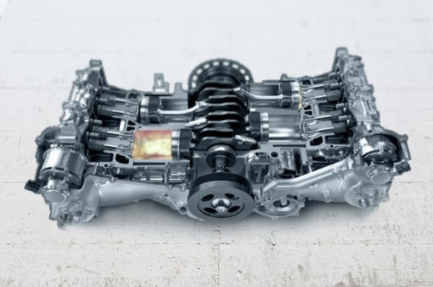
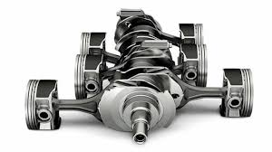
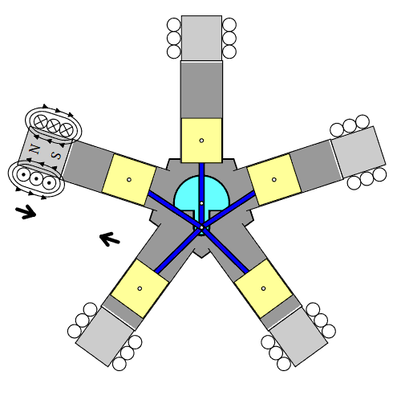
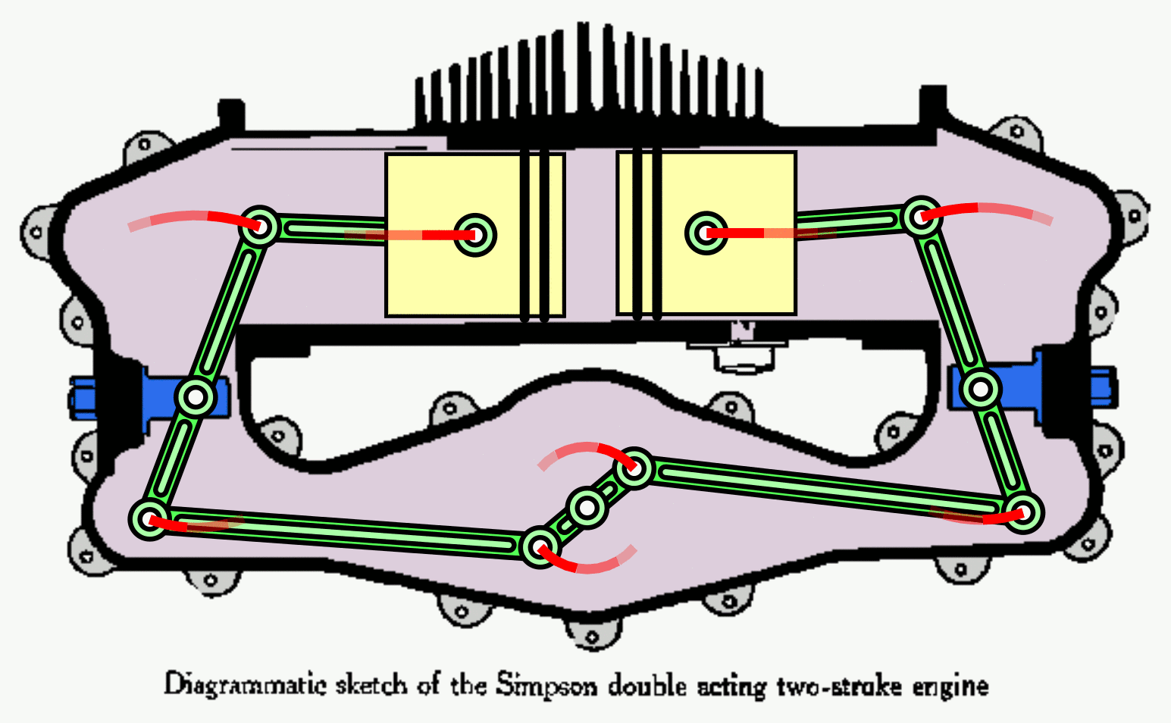
Engine Classification
Arrangement of cylinders:
Flat or opposed cylinder (V with 180⁰):
two banks of cylinders opposite each other on a single crankshaft (smallaircrafts)
Opposed piston engine:
two pistons in each cylinder, combustion chamber between pistons
Radial engine:
cylinders positioned radially around crankshaft.

Slide 26

Problem 1
A six-cylinder two-stroke engine with a compression ratio r = 9 produces a torque of 1100 Nm at a speed of 2100 rpm. It has a bore b of 123 mm and a stroke s of 127 mm.
What is the displacement volume and the clearance volume of a cylinder?
mean piston speed
Solution:
V_{d} = (π/4) * b² * L
We know that r = (V_{d} + V_{c})/ V_{c}
U_{p} = 2NL/60

Slide 27
Problem 1
A six-cylinder two-stroke engine with a compression ratio r = 9 produces a torque of 1100 Nm at a speed of 2100 rpm. It has a bore b of 123 mm and a stroke s of 127 mm.
What is the displacement volume and the clearance volume of a cylinder?
mean piston speed
Solution:
V_{d} = (π/4) * b² * L
= 1.51 × 10⁻³m³
We know that r = (V_{d} + V_{c})/ V_{c}
The clearance volume, V_{c} = V_{d} /(r −1)
= 1.89 × 10⁻⁴ m³
U_{p} = 2NL/60 = 2 * (2100/60) * 0.127 =8.89 m/s

Slide 28
Problem 2
A three-liter SI V6 engine that operates on a four-stroke cycle at 3600 RPM. The compression ratio is 9.5, length of the connecting rods is 16.6 cm, the engine is square (B=L) Calculate:
Cylinder bore
Stroke length
Average piston speed
Clearance volume of one cylinder
Solution:a. Given, Swept volume, Vs=3×10⁻³m3 RPM of engine, N = 3600
The engine bore, B=? Stroke length, L =?
We know, V_{s}= n×(𝜋/4×B²×L )
(here n is no. of cylinder)/

Slide 29
Problem 2
Since B = L, so L = 0.086 m
Average piston speed Sp =?
We know, Sp = 2NL
= 2×3600×0.086 m
= 2×(3600/60)×0.086 m
= 10.32 m/s
Clearance volume of one cylinder: the clearance volume for one cylinder, We know that r = (V_{d} + V_{c})/ V_{c}
The clearance volume, V_{c} = V_{d} /(r −1)= 352.941 cm³
V_{C} = 352.941/6 cm³ = 58.82 cm³ ≈ 59 cm³

Slide 30
Acknowledgement
Slide Courtesy:
Dr. Aman Uddin, Assistant Professor, Department of Mechanical Engineering, BUET
Saif Al-Afsan Shamim, Assistant Professor, Department of Mechanical Engineering, BUET

